Slide 1
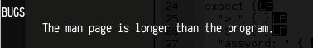
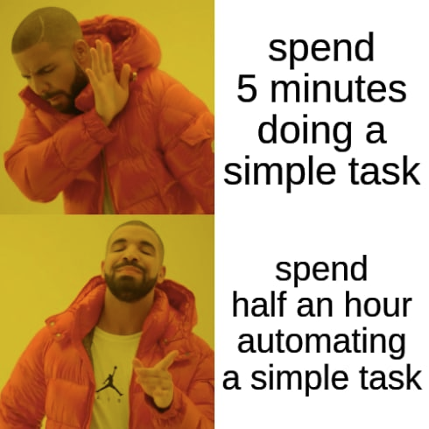
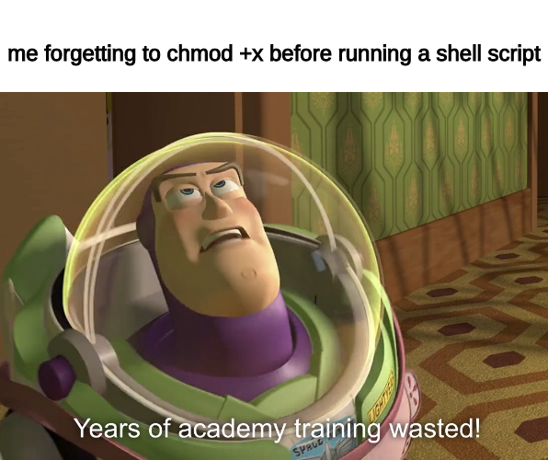
COMP2041
Week 3

Slide 2
Announcements
Welcome to Week 3 of COMP2041
Lab 1 and 2 was due today (Tuesday 12PM AEST)
Lab 3 due Week 4 Monday 12PM AEST (midday)
Week 03 Weekly Test available soon
As of Tuesday, watch the lecture for more details
Taken under exam conditions
AFAIK one attempt, one hour but confirm at Lecture

Slide 3

Overview
Shell Scripting
Tutorial Questions

Slide 4
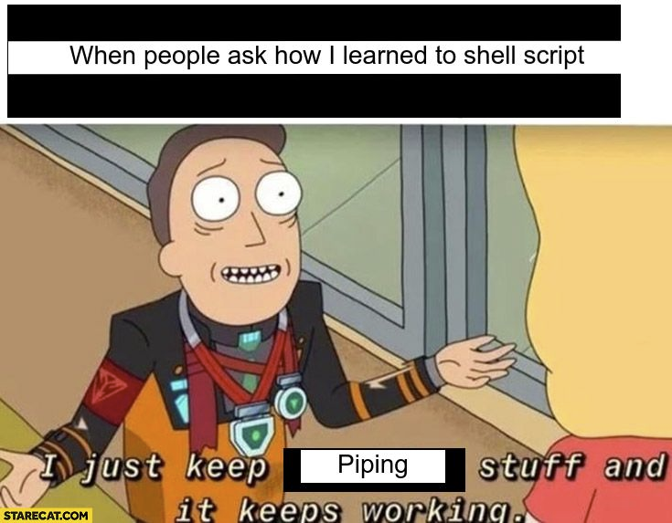
Shell
Scripting

Slide 5
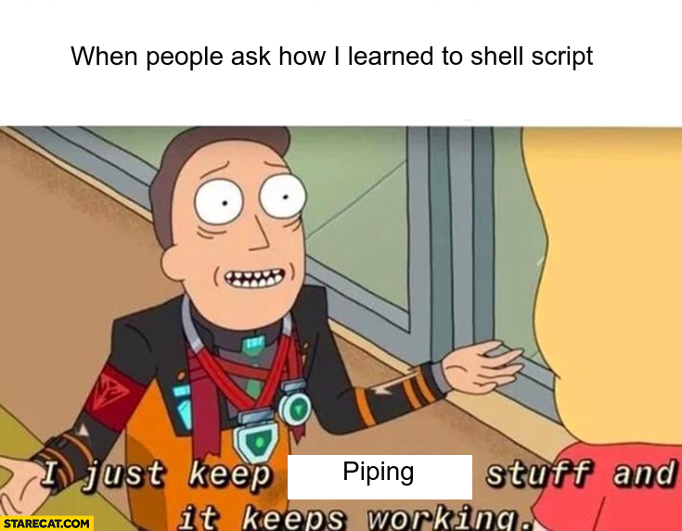
Shell Scripting
In weeks 1 and 2, we have learnt how to use various command line tools
Shell scripting allows us to automate the usage of command line tools with additional logic
Shell scripts work in all machines by default, which makes them incredibly useful because nothing needs to be pre-installed, and interacts directly with OS

Slide 6
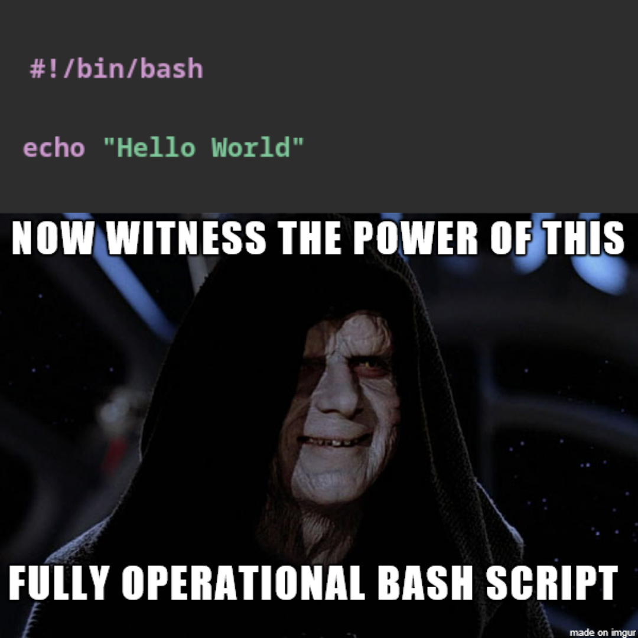
echo / Quotes
Literally just printf (or print if you’ve done Python before)
echo hello world
echo ‘hello world’
echo hello world
echo ‘hello world’
Single quotes: plain string
Double quotes: variables are parsed

Slide 7

Variables Expansion
~: Home Directory
$: accessing variables e.g. echo “$HOME”
$(command): accessing commands e.g. echo “$(date)”, echo “$(whoami)”
$(()): arithmetics e.g. echo “$((6*3+3))” What if we want to do 6*(3+3)?

Slide 8
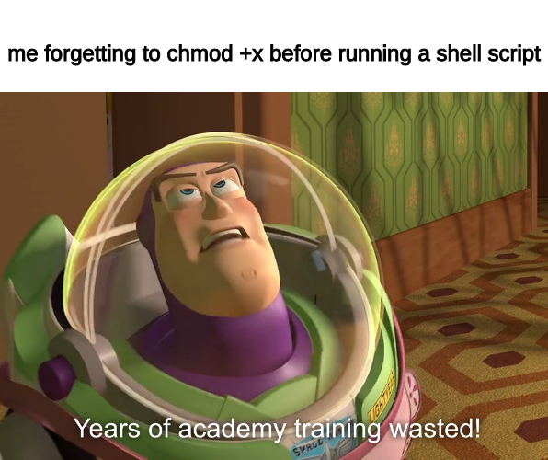
Variables in Shell Scripting
Weirdly enough, $ is needed when accessing variables, but not needed when editing them.
All variables are initialised as an empty string by default. No need to initialise
Examples: $moo (I wrote this line just in case someone needs to reference when reading the slides again).
Let’s try these in Shell Scripts
IMPORTANT: on CSE machines, ALWAYS use chmod u+x script.sh or else ur command will not run

Slide 9
Built-in Variables
$0: command name
$1: first 'command line argument' -> explain what command line arguments are
$2: second 'command line argument‘
$#: number of command line arguments
$@: all command line arguments
$?: exit status (comment out cd and show them the difference)

Slide 10

Globbing
Limited regex for filenames
* - wildcard
? - wildcard, but for only one character
[ ] - enclosed characters only, similar to Regex
! - NOT
Globbing is NOT meant to be put inside double quotes.

Slide 11
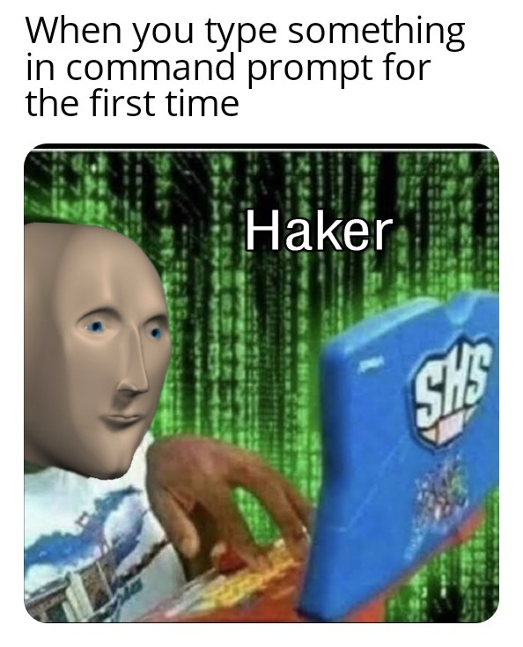
I/O Redirection
< infile: connect stdin to the file infile
> outfile: send stdout to the file outfile
>> outfile: append stdout to the file outfile
2>/dev/null: send errors to null, silencing outputs made by commands and replacing it on our own (quite useful in labs & assignments when we want to use our own error messages)

Slide 12

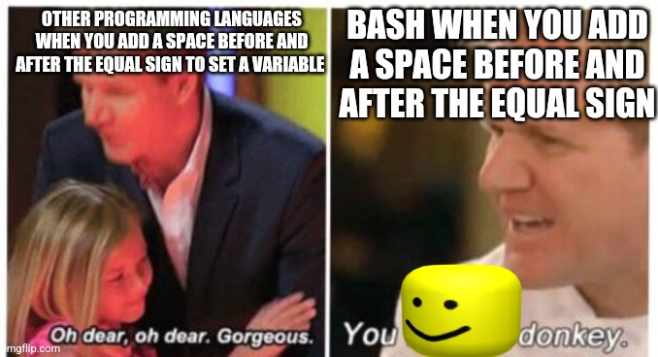

test / if / while / for
Better shown than explained (example code will be uploaded)

Slide 13
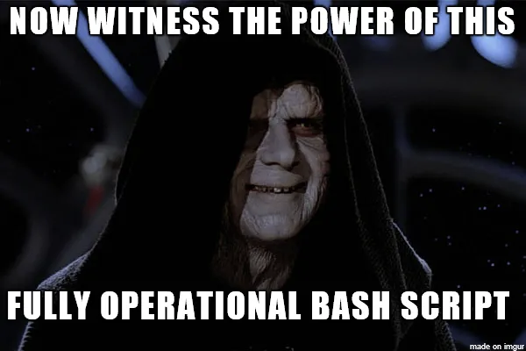
Tutorial Questions

Slide 14

To The
Lab!

